Slide 1
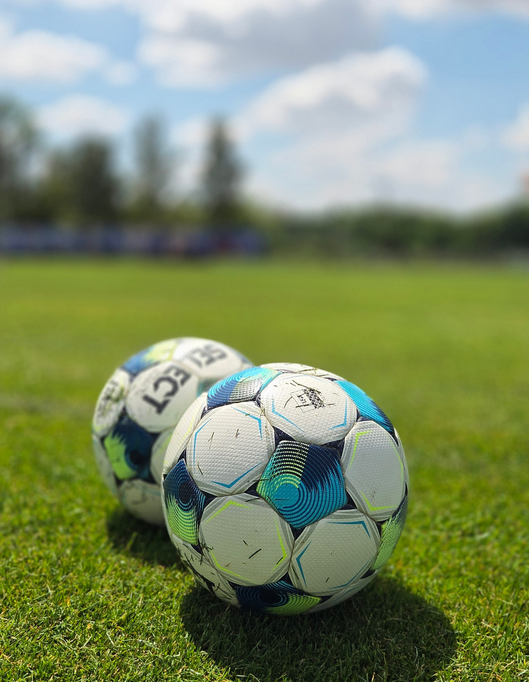
GAMEVIO
GAMEVIO
for agencies
PORTFOLIO
×
PERFORMANCE
×
CARE
One current overview of players, workload, form and next steps.
gamevio.pro
Notes:
Otevřete tématem kontroly: agentura potřebuje vědět, co se s každým hráčem děje právě teď.
[Sources]
- Internal GAMEVIO product materials and user-approved second-deck focus: player agencies.
- Asset: public/media/agency-cover-balls.jpg (user-provided training photograph).
[/Sources]

Slide 2
PORTFOLIO
02
One profile. The full player context.
FICTIONAL SAMPLE PROFILE
Performance, contract, costs and the next development step in one place.
JACOB NOVAK
ACTIVE PROFILE
UPCOMING SCHEDULE
17
22 years · ST / RW · right-footed
What comes next.
22. 8.
TRAINING
10:00
CLUB
YEAR-ON-YEAR TREND
2025
2026
FRI
Orion Training Centre
FC Orion Praha
COSTS
210 tis.
23. 8.
GYM
09:30
186 tis.
−11 %
SAT
Prague Performance Lab
CONTRACT UNTIL
30. 6. 2028
VALUE*
€ 0,9 m
25. 8.
PHYSIOTHERAPY
14:00
€ 1,2 m
+33 %
MON
Letná Sports Clinic
ACTIVE INDEX
64 %
MATCH
18:00
82 / 100
WORKLOAD
+14 b.
27. 8.
78 %
WED
Park Stadium
* Illustrative value. All data on this slide is fictional.
Times and venues are part of this fictional sample profile.
gamevio.pro · info@gamevio.pro
Notes:
Ukažte, že agent vidí obchodní, sportovní i rozvojový kontext bez přepínání mezi tabulkami.
[Sources]
- All names, clubs, dates, costs and performance values on this slide are fictional examples.
- The profile intentionally uses a typographic avatar instead of a real player photograph.
[/Sources]

Slide 3
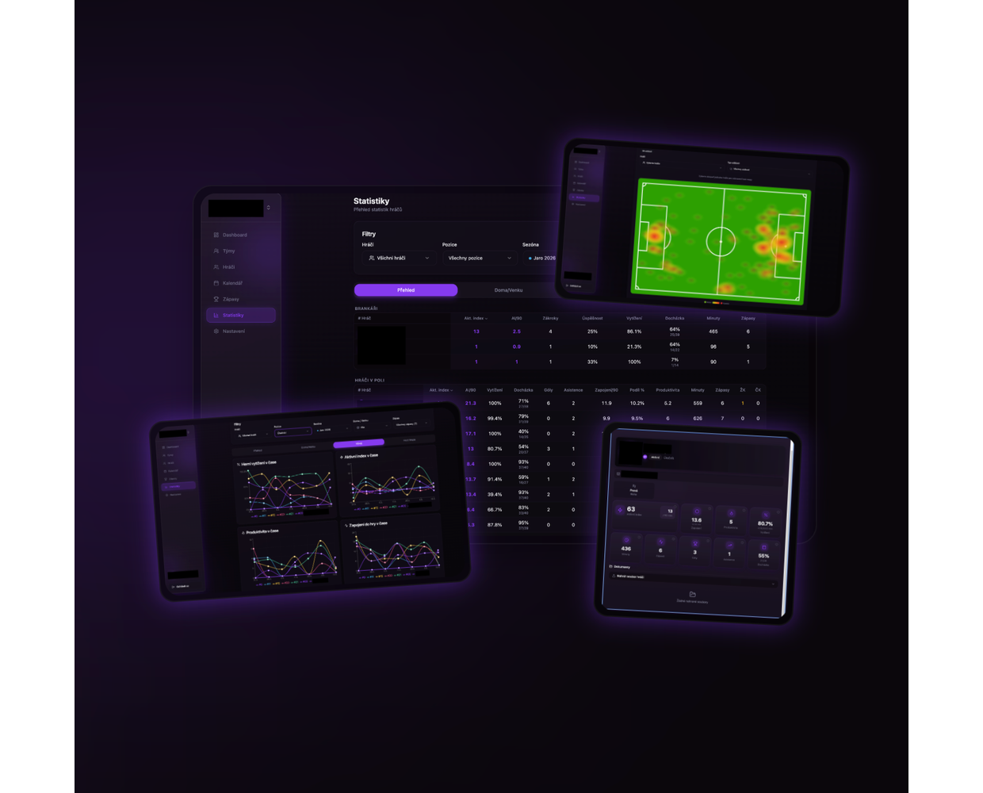
360° PROFILE
03
One profile holds the complete player context.
Sporting, operational and contract information meet in one current overview.
●
Club, role and calendar
●
Matches, minutes and workload
●
Productivity, involvement and active index
●
Documents, contracts and next step
gamevio.pro · info@gamevio.pro
Notes:
Vysvětlete, že profil není statická karta. Je to živý pracovní kontext hráče.
[Sources]
- User-provided GAMEVIO feature brief.
- Asset: public/media/gamevio-devices.png (GAMEVIO product screenshot).
[/Sources]

Slide 4
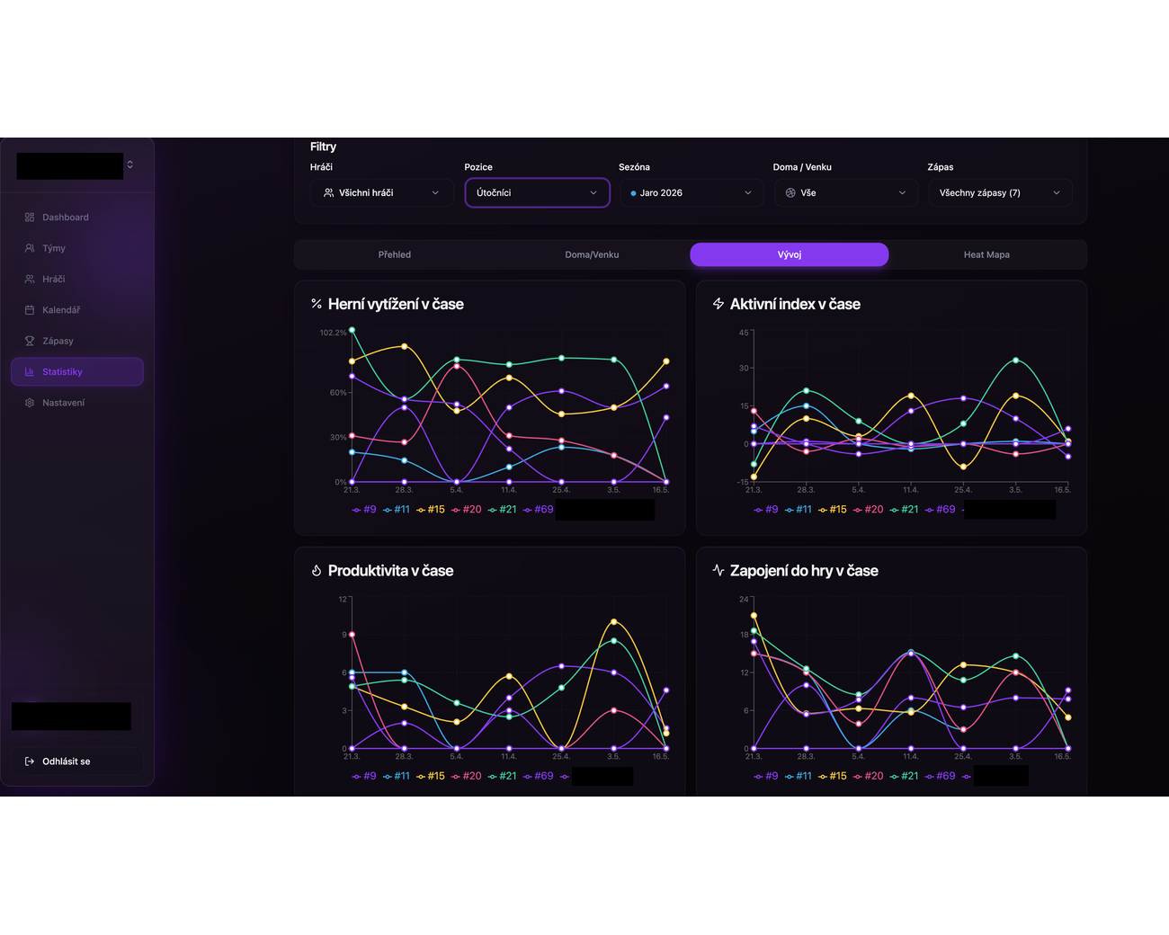
FORM OVER TIME
04
Form and workload are visible before they become a problem.
The trend separates a short-term fluctuation from a change that needs action.
WORKLOAD
PRODUCTIVITY
INVOLVEMENT
gamevio.pro · info@gamevio.pro
Notes:
Agentura může reagovat na trend, ne až na telefonát po několika zápasech bez minut.
[Sources]
- User-provided feature brief.
- Asset: public/media/gamevio-charts.png (GAMEVIO performance charts screenshot).
[/Sources]

Slide 5
DAILY CONTROL
05
Calendar, contracts and costs in one place.
Operational clarity creates room for sporting care and club negotiations.
01
02
03
CALENDAR
CONTRACTS
COSTS
Where the player competes, trains and what is coming next.
Deadlines, documents and steps in planned transfers.
Representation expenses in context.
gamevio.pro · info@gamevio.pro
Notes:
Tato provozní vrstva je základ. Hlavní diferenciace ale přichází na dalších slidech přes výkon a péči.
[Sources]
- Existing GAMEVIO agency page in the workspace: calendar, contracts/transfers and costs.
[/Sources]

Slide 6
EARLY SIGNAL
06
An early signal is stronger than a retrospective explanation.
GAMEVIO helps identify situations that need attention before they affect a career.
DECLINING MINUTES
RISING LOAD
The player is losing their role in the team.
There is a risk of overload or reduced quality.
PRODUCTIVITY CHANGE
OUT OF COMPETITIVE RHYTHM
The result no longer matches the previous trend.
It is time to activate an individual plan.
gamevio.pro · info@gamevio.pro
Notes:
Zdůrazněte, že systém upozorňuje na signál. Rozhodnutí zůstává na agentovi a hráči.
[Sources]
- Illustrative risk signals synthesized from the user-provided metrics and agency workflow; no predictive-accuracy claim.
[/Sources]

Slide 7
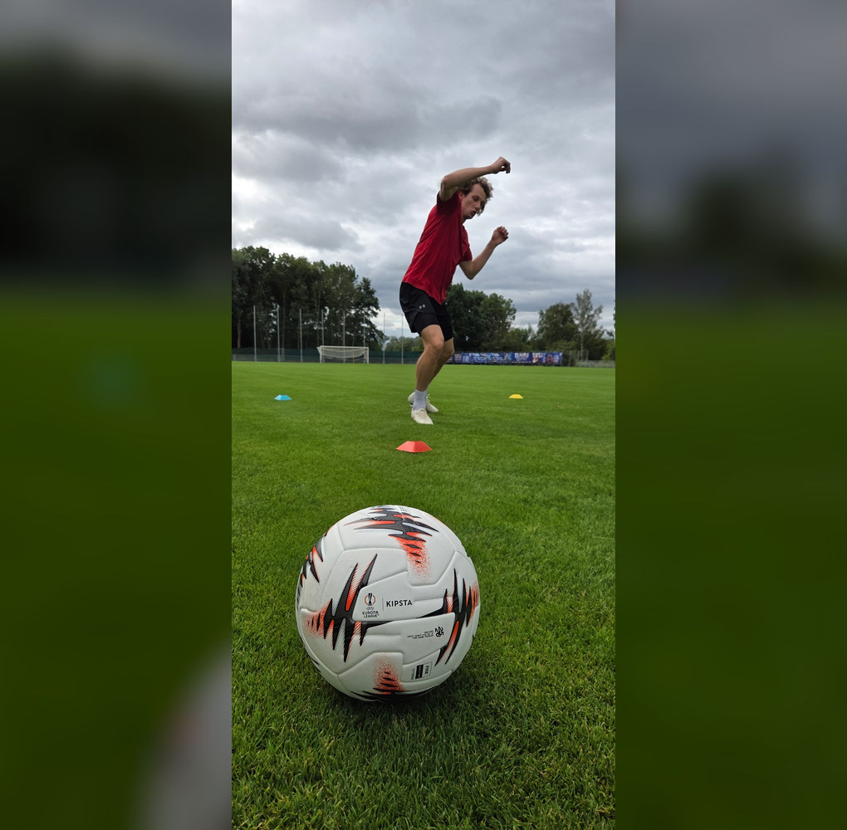
CONNECTED SYSTEM
07
GAMEVIO
×
INDIVIDUAL
Data reveals the need. Training turns it into specific work. The next matches measure the result.
●
Identify the game situation
●
Individual plan and execution
●
Verify transfer into the match
gamevio.pro · info@gamevio.pro
Notes:
Toto je nejsilnější systémová výhoda: data nekončí v reportu, ale vedou ke konkrétní intervenci.
[Sources]
- User-provided positioning: GAMEVIO application combined with GAMEVIO Individual training.
- Asset: public/media/individual-gallery/training-04.jpg (user-provided training photograph).
[/Sources]

Slide 8
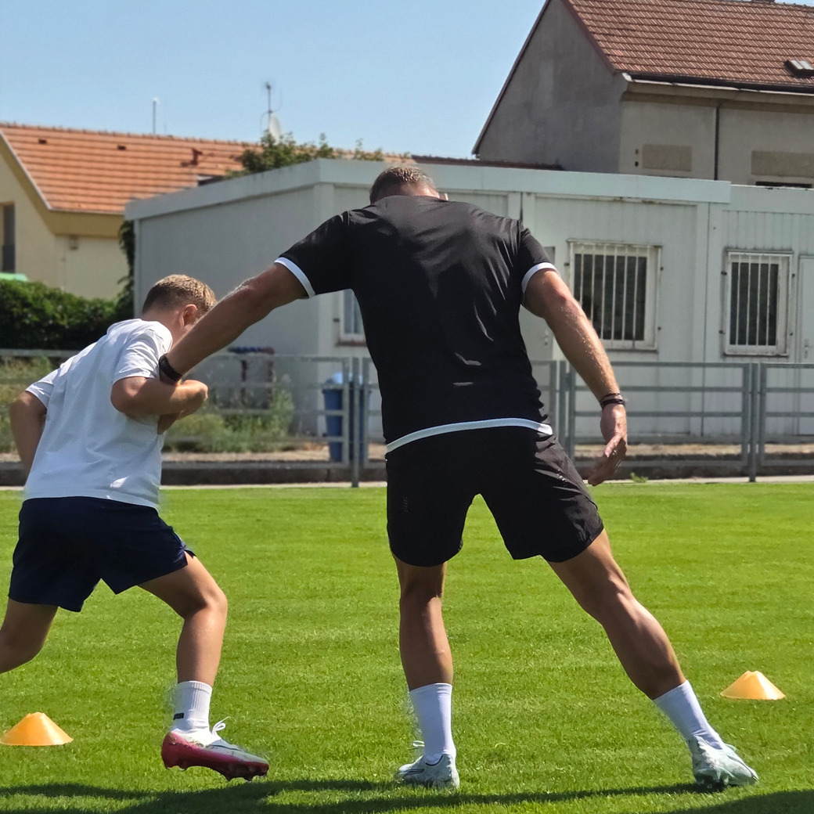
TRAINING PLANS
08
A training plan protects the investment in a player.
An unsigned or off-season player does not have to lose rhythm or performance.
●
Optimal plan for the player's position and current condition
●
Facilities and suitable training partners
●
Performance continuity during transition
●
Measurable return to club routine
gamevio.pro · info@gamevio.pro
Notes:
Použijte formulaci ochrany investice citlivě: jde o péči o kariéru a připravenost hráče.
[Sources]
- User-provided agency positioning: off-season or unsigned players receive training plans, facilities and partners to protect performance and the agency's investment.
- Asset: public/media/individual-gallery/training-06.jpg (user-provided training photograph).
[/Sources]

Slide 9
REPORTING
09
A professional report makes club discussions easier.
Instead of impressions, the agency brings a clear view of performance, trend and context.
PERFORMANCE
TREND
CONTEXT
current match data
workload and productivity trend
role, competition and next step
Better evidence for renewals, loans, transfers and individual plans.
gamevio.pro · info@gamevio.pro
Notes:
Report není skautský verdikt. Je to jednotný podklad pro profesionální rozhovor.
[Sources]
- Benefits synthesized from the user-provided GAMEVIO performance and agency-management feature set.
[/Sources]

Slide 10






TRAINED WITH US
10
Players who have been through our programme.
From Czech competitions to European leagues.
And many more.
Alex Král
Vladimír Coufal
Divine Onyemachi
FC København
TSG 1899 Hoffenheim
U.S. Lecce U20
3F Superliga
Bundesliga
Primavera 1
Antonín Vaníček
Matouš Krulich
Filip Havelka
FC Zbrojovka Brno
FK Příbram
Free agent
Chance Liga
Czech National Football League
Individual preparation
gamevio.pro · info@gamevio.pro
Notes:
Fotografie jsou sjednoceny jemným snížením kontrastu a sytosti. U Filipa Havelky je uveden aktuální stav bez klubového angažmá, aby prezentace nevytvářela neověřený údaj.
[Sources]
- https://www.fck.dk/en/news/fc-copenhagen-sign-alex-kral
- https://www.bundesliga.com/de/spieler/vladimir-coufal
- https://www.transfermarkt.com/divine-onyemachi/profil/spieler/1117532
- https://www.chanceliga.cz/hrac/3441-antonin-vanicek
- https://www.fkpribram.cz/hrac.asp?id=1479&kategorie=MUZ&sezona=2025
- https://www.transfermarkt.com/filip-havelka/transfers/spieler/318099
- User-provided player photographs: /Users/ondrej/Downloads/Hráči/
[/Sources]

Slide 11
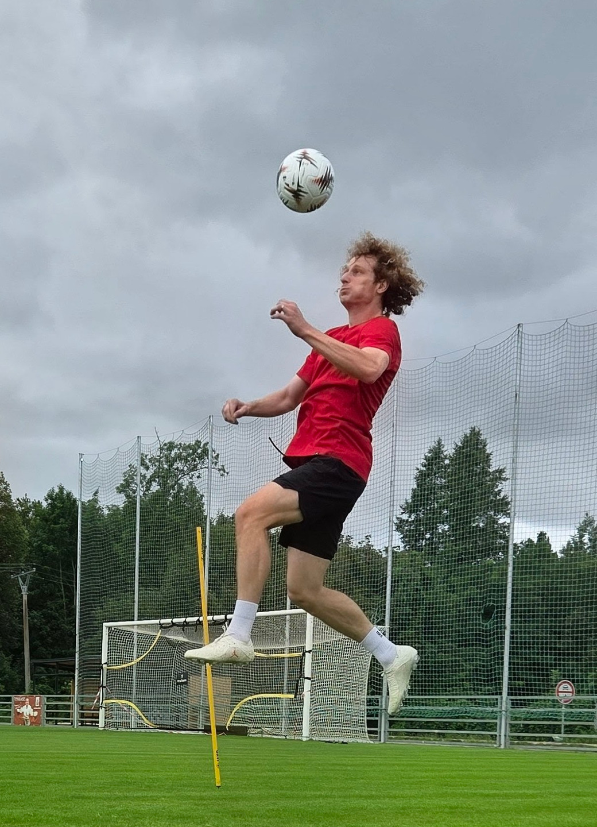
GAMEVIO FOR AGENCIES
We take care of your players. We prepare them for the European level.
Let us demonstrate GAMEVIO using your portfolio and a specific care scenario.
Book a demo →
Notes:
Navažte konkrétní výzvou. Kontaktní údaje a profesní profil následují na samostatném slidu.
[Sources]
- User-approved agency CTA copy.
- Asset: public/media/alex-training.jpg (user-provided player training photograph).
[/Sources]

Slide 12
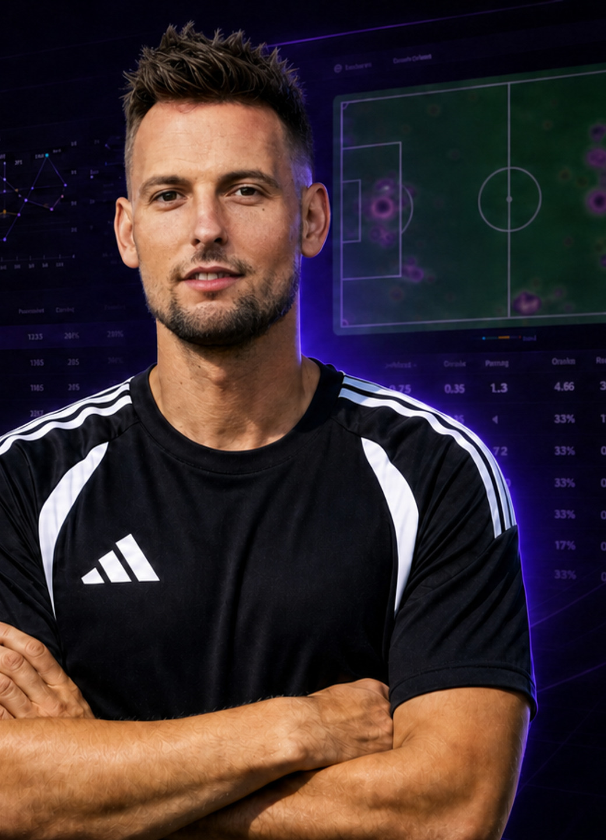



CONTACT
Ondřej Štěpánek
Founder @ GAMEVIO | Video & Data Analyst |
Process Engineer | Product Builder |
UEFA Licensed Football Coach |
Barca Inovation Hub
info@gamevio.pro
+420 601 096 995
gamevio.pro
FAČR
UEFA
Licensed coach
Licensed coach
Student
Notes:
Uzavřete osobně: stručně představte profesní přesah mezi coachingem, datovou analýzou, procesy a produktovým vývojem. Poté nabídněte konkrétní další krok.
[Sources]
- User-provided professional description and contact: info@gamevio.pro, gamevio.pro.
- Asset: public/og-face-v4.png (user-approved website hero portrait).
- https://www.uefa.com/
- https://www.fotbal.cz/facr/facr-predstavuje-novou-grafickou-identitu-a-modernizovane-logo/a14699
- https://barcainnovationhub.fcbarcelona.com/the-hub/
- The logos indicate qualifications or education context; they do not claim commercial partnership or endorsement.
[/Sources]

