Slide 1
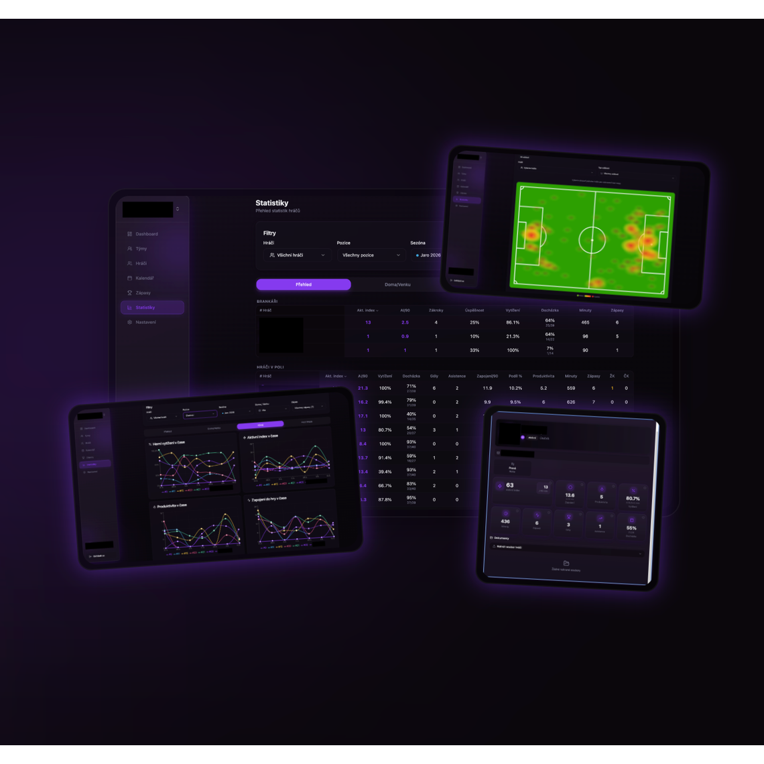
GAMEVIO
GAMEVIO
for clubs
OPERATIONS
×
PERFORMANCE
×
PROGRESS
One system for daily club operations and decisions based on what actually happens on the pitch.
gamevio.pro
Notes:
Otevřete kontrastem: klub nepotřebuje další kalendář, ale jeden provozní a výkonnostní systém.
[Sources]
- Internal GAMEVIO product materials and user-provided feature brief.
- Asset: public/media/gamevio-devices.png (GAMEVIO product screenshot).
[/Sources]

Slide 2
THE PROBLEM
02
Most club apps stop at attendance.
Attendance matters. But it cannot explain why a team improves — or where progress is being lost.
A TYPICAL APP
GAMEVIO
Who is coming?
When is training?
Where is the match?
What happened in the match?
How did players affect the game?
Where is the team heading?
gamevio.pro · info@gamevio.pro
Notes:
Nezlehčujte docházku. Vysvětlete, že GAMEVIO na ní staví a přidává výkonnostní vrstvu.
[Sources]
- User-provided feature brief and comparative positioning; no external market-share claim.
[/Sources]

Slide 3
CLUB ORGANISATION
03
One club. Multiple teams. One system.
Management sets one standard, coaches run their teams and everyone sees only what they need.
01
02
03
04
MANAGEMENT
FIRST TEAM
ACADEMY
STAFF
club-wide overview
own calendar and data
one system from day one
clear roles and ownership
Central organisation without taking autonomy away from individual teams.
gamevio.pro · info@gamevio.pro
Notes:
Zdůrazněte, že více týmů neznamená více izolovaných tabulek ani skupinových chatů.
[Sources]
- User-provided requirement: multi-team club organization.
- Internal GAMEVIO site copy: teams, calendar, player management and roles.
[/Sources]

Slide 4
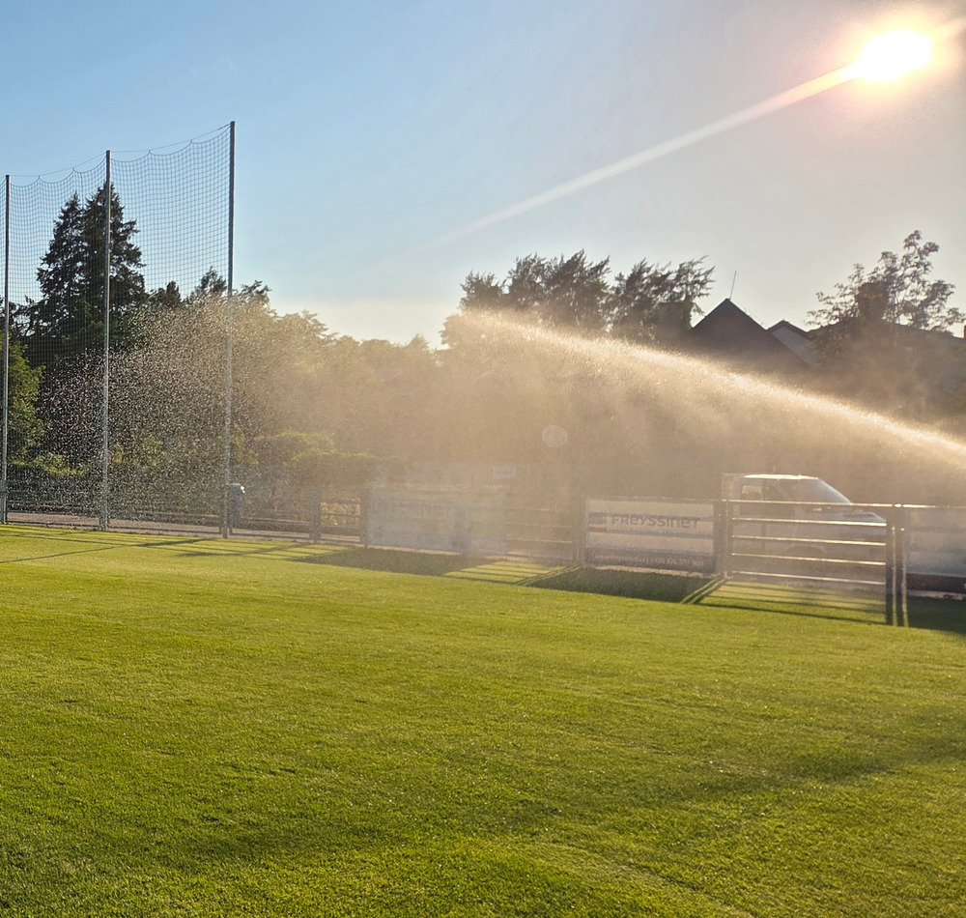
DAILY OPERATIONS
04
Every event has a clear status.
Training, matches and team meetings are planned in one place — including player availability.
●
Attendance and confirmations
●
Holiday and absence planning (injury, illness)
●
Voting for individual events
●
User notifications
●
Event selections
●
Overview for players, parents and staff
●
Time, venue, meeting and instructions
●
Connections to FAČR, Google Maps, Slack and more
●
Automatic voting launch
gamevio.pro · info@gamevio.pro
Notes:
Přeložte funkce do reality: trenér před tréninkem ví, kdo přijde a koho musí nahradit.
[Sources]
- User-provided feature brief.
- Asset: public/media/training-field.jpg (user-provided training venue photograph).
[/Sources]

Slide 5
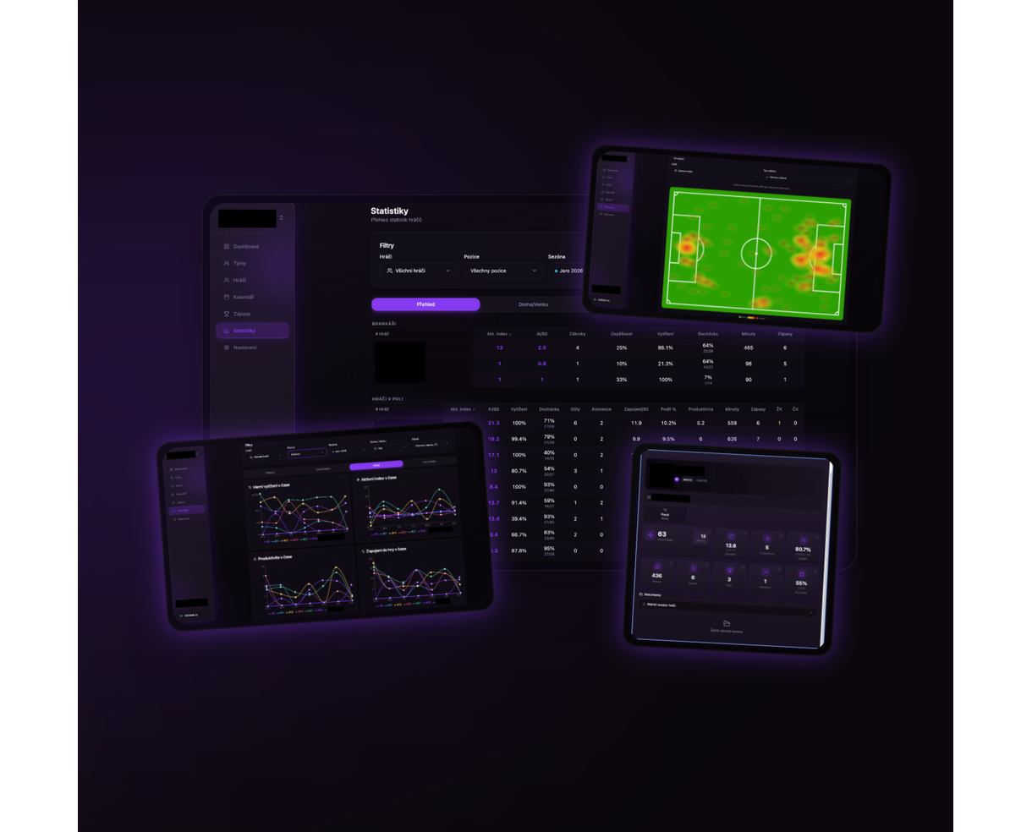
PLAYER PROFILE
05
The player profile connects availability and performance.
One place for the long-term player picture — not just an isolated match record.
01
02
ATTENDANCE & AVAILABILITY
MINUTES & MATCHES
03
04
PLAYER STATISTICS
DEVELOPMENT OVER TIME
gamevio.pro · info@gamevio.pro
Notes:
Profil hráče je společný kontext pro trenéra, vedení klubu i hráče.
[Sources]
- User-provided feature brief.
- Asset: public/media/gamevio-devices.png (GAMEVIO product screenshot).
[/Sources]

Slide 6
LIVE MATCH
06
Match data is captured live.
Events are recorded during the match and instantly create a team and individual performance picture.
12:08
ball recovery
+3
LIVE
24:41
key pass
+5
A scoring model inspired by Opta Points turns match events into a clear index.
38:16
shot on target
+4
61:09
turnover under pressure
−2
gamevio.pro · info@gamevio.pro
Notes:
Upozorněte, že příklady bodů jsou ilustrativní. Principem je jednotné hodnocení událostí.
[Sources]
- User-provided requirement: live event tracking with statistics inspired by Opta Points.
- Illustrative event examples; not real match data.
[/Sources]

Slide 7
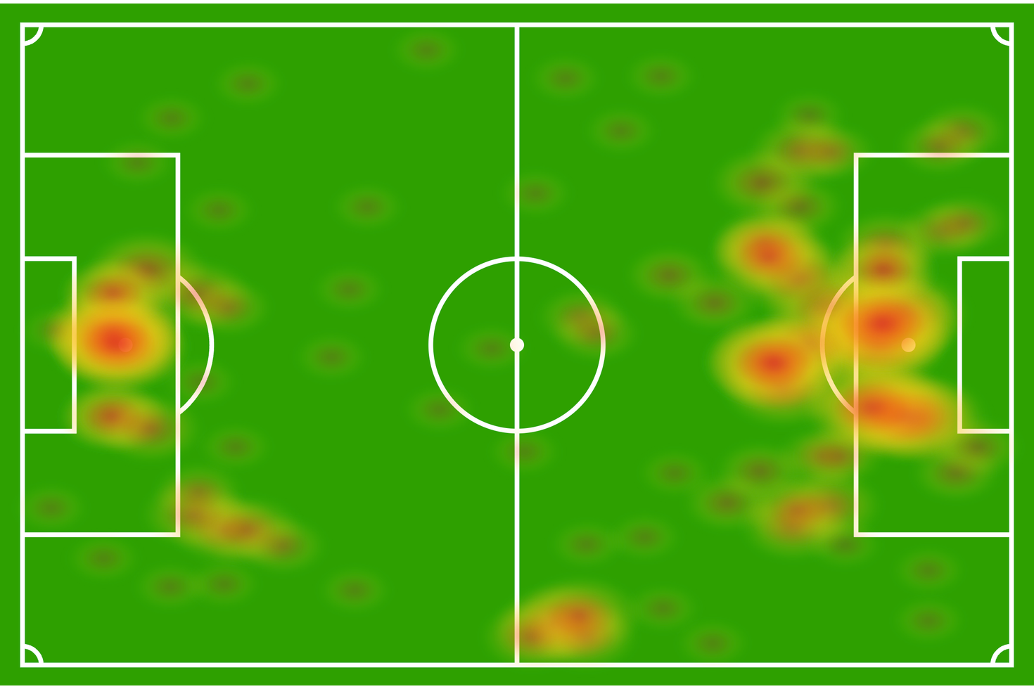
SPATIAL DATA
07
A heat map shows where a player affects the game.
The spatial footprint adds context to statistics: position, activity and recurring game habits.
WHERE
×
HOW OFTEN
gamevio.pro · info@gamevio.pro
Notes:
Heat mapa není dekorace. Pomáhá trenérovi ověřit, zda hráč plní prostorovou roli.
[Sources]
- User-provided feature brief.
- Asset: public/media/gamevio-heatmap.png (GAMEVIO heat map screenshot).
[/Sources]

Slide 8
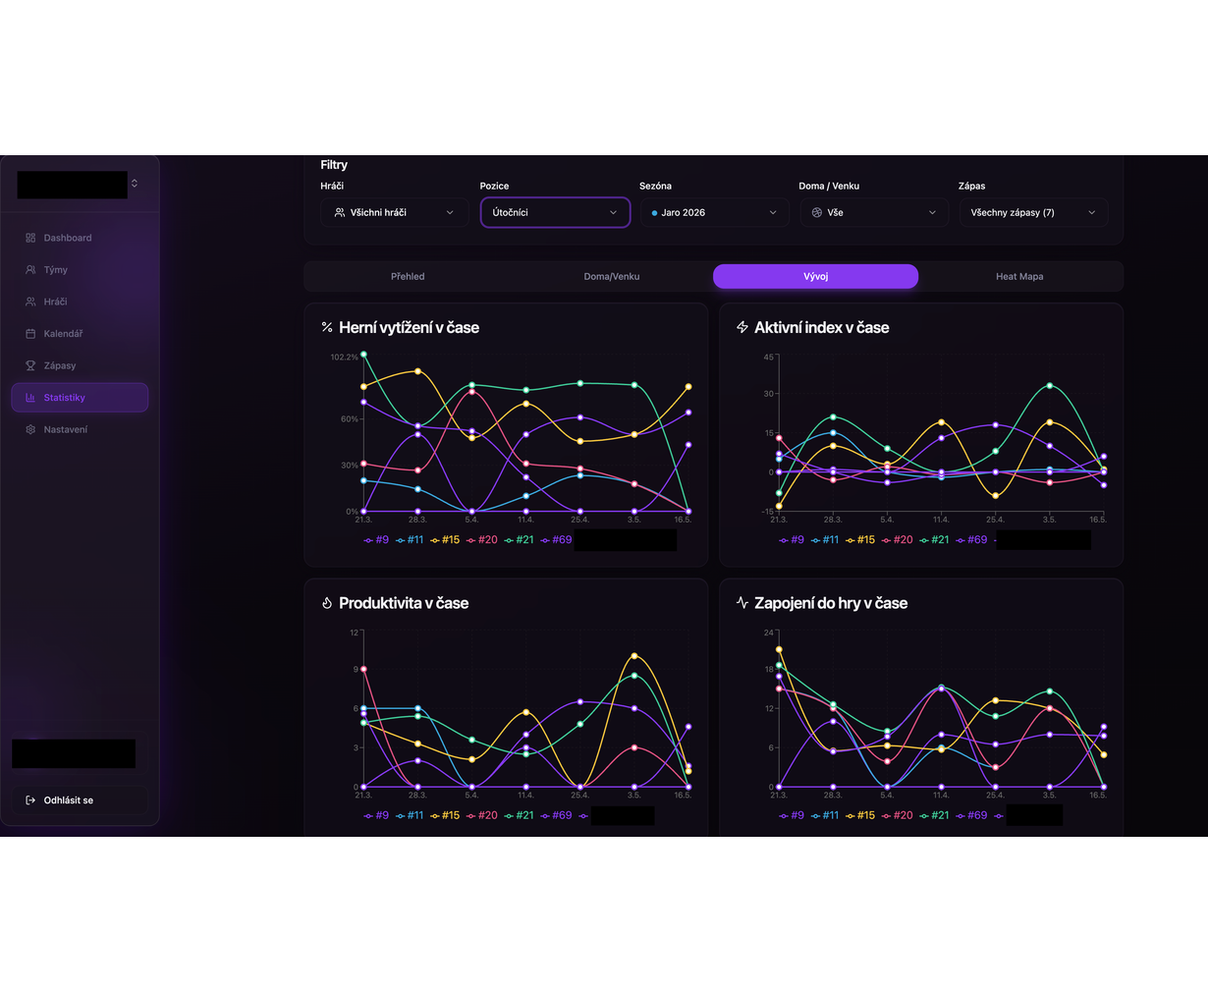
PERFORMANCE
08
Performance is more than goals.
GAMEVIO tracks how a player contributes to the game — in each match and over time.
●
Productivity
●
Game involvement
●
Active index
●
Workload over time
gamevio.pro · info@gamevio.pro
Notes:
Tady vysvětlete význam metrik, nikoli technický výpočet. Trenér potřebuje trend a kontext.
[Sources]
- User-provided feature brief.
- Asset: public/media/gamevio-charts.png (GAMEVIO performance charts screenshot).
[/Sources]

Slide 9
FOR COACHES
09
Less administration. Better decisions.
GAMEVIO gives coaches time back and adds verifiable context to their intuition.
01
02
03
Sestava bez chaosu
Match-led training
Specific feedback
Availability, attendance and workload in one place.
Data shows which situations need to be trained again.
The player gets a clear example, not a vague impression.
04
05
06
Development over time
A shared language for staff
Faster preparation
The coach compares the trend, not only the latest result.
Everyone works with the same information.
Less manual entry, more time on the pitch.
gamevio.pro · info@gamevio.pro
Notes:
Toto je sekce přímo pro trenéry. U každého bodu použijte krátký příklad z běžného týdne.
[Sources]
- Benefits synthesized from user-provided GAMEVIO feature set and coaching workflow.
[/Sources]

Slide 10
FOR CLUB MANAGEMENT
10
Management sees progress across teams.
One system creates continuity from the academy to the first team and supports sporting decisions.
1
360°
N
DATA WORKING STANDARD
PLAYER OVERVIEW
TEAMS IN ONE CLUB
The result is not more reports. It is faster agreement on what the club should do next.
gamevio.pro · info@gamevio.pro
Notes:
Pro vedení je důležitá konzistence a návaznost. Nezahlcujte je detailními statistikami.
[Sources]
- User-provided requirement: club organization across multiple teams.
- Benefits synthesized from the described GAMEVIO operating model.
[/Sources]

Slide 11
THE DIFFERENCE
11
GAMEVIO does not stop at attendance.
It connects club operations with a performance layer that gives events and matches context.
FEATURE
TYPICAL ATTENDANCE APP
GAMEVIO
Attendance, calendar, voting
✓
✓
Multiple teams in one club
partly
✓
Live match events
—
✓
Player and team statistics
—
✓
Heat mapa
—
✓
Productivity, involvement, active index
—
✓
Long-term player progress
—
✓
gamevio.pro · info@gamevio.pro
Notes:
Formulujte jako rozdíl v rozsahu řešení, ne jako absolutní soud o všech konkurentech.
[Sources]
- Comparison based on the user-provided positioning: common attendance apps focus on operations, while GAMEVIO also covers performance and progress.
- No named competitor or audited market benchmark is claimed.
[/Sources]

Slide 12

GAMEVIO FOR CLUBS
Run your club by what actually happens on the pitch.
Let us demonstrate GAMEVIO using real situations from your club.
gamevio.pro
Notes:
Uzavřete konkrétní výzvou: vyberte jeden tým a jeden zápas pro pilotní ukázku. Kontaktní údaje následují na samostatném slidu.
[Sources]
- Asset: public/media/training-detail.jpg (user-provided football photograph).
[/Sources]

Slide 13




CONTACT
Ondřej Štěpánek
Founder @ GAMEVIO | Video & Data Analyst |
Process Engineer | Product Builder |
UEFA Licensed Football Coach |
Barca Inovation Hub
info@gamevio.pro
+420 601 096 995
gamevio.pro
FAČR
UEFA
Licensed coach
Licensed coach
Student
Notes:
Uzavřete osobně: stručně představte profesní přesah mezi coachingem, datovou analýzou, procesy a produktovým vývojem. Poté nabídněte konkrétní další krok.
[Sources]
- User-provided professional description and contact: info@gamevio.pro, +420 601 096 995, gamevio.pro.
- Asset: public/og-face-v4.png (user-approved website hero portrait).
- https://www.uefa.com/
- https://www.fotbal.cz/facr/facr-predstavuje-novou-grafickou-identitu-a-modernizovane-logo/a14699
- https://barcainnovationhub.fcbarcelona.com/the-hub/
- The logos indicate qualifications or education context; they do not claim commercial partnership or endorsement.
[/Sources]

